Slide 1
Hypercube: a DOE-informed hyperparameter optimization machine
ISYE 6413
Kaiwen Wang, Xiaochen Yan

Slide 2
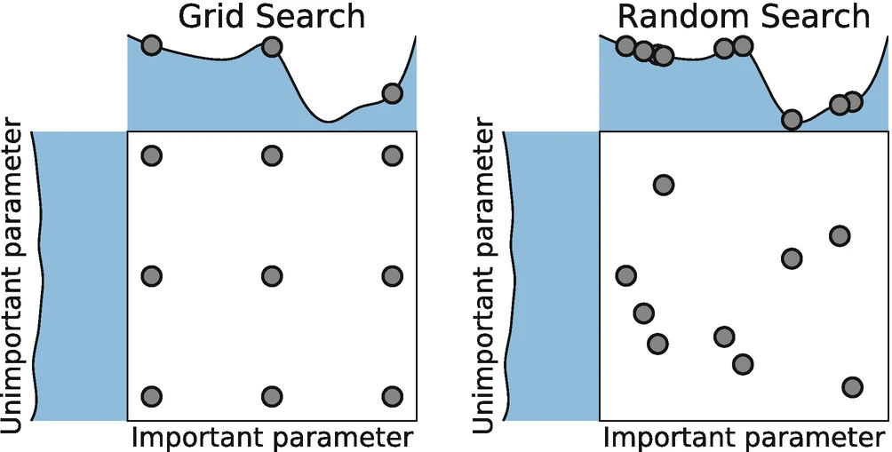
Problem
Good hyperparameters -> good models (CV & metrics)
Approaches: searches, Sequential Monte Carlo, Optimization, etc.
Traditional methods -> expensive and suboptimal
Novel methods -> lack interpretability

Slide 3
Methods
Latin hypercube (maximin)
Response surface methodology
Factorial design, regression, ANOVA

Slide 4
Implementation
LHSTuner: Latin hypercube + Gaussian Process
Surf: First & second order designs + steepest ascent (sequential)
OFAT: factorial design + regression/ANOVA
GitHub: https://github.com/mstrmnd1/hypercube

Slide 5
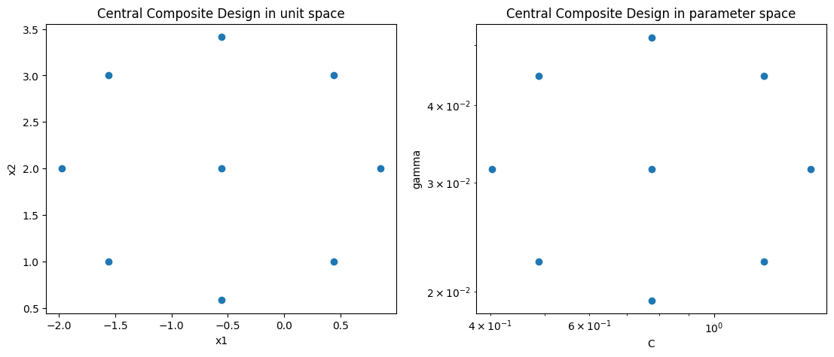
Notes:
Central Composite Design for the Response Surface method
Left unit space – convert – right parameter space

Slide 6
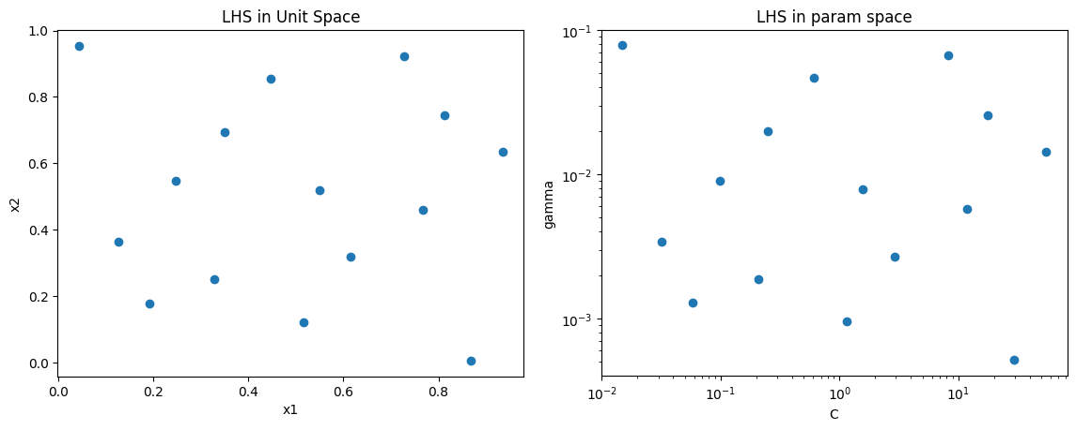
Notes:
Maximin Latin Hypercube Design
If we draw a grid, we can see that every column and every row contain exactly 1 sample
Maximin: ensuring a space - filling distribution of the points.
maximizing the minimum distance between any two points in a design, thereby

Slide 7
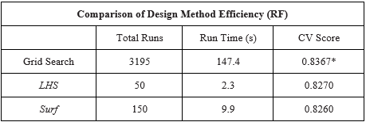
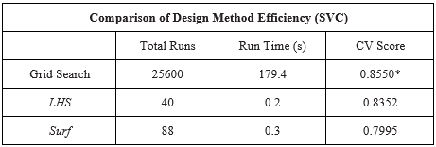
Analysis
Synthetic classification dataset
Models: SVM and Random Forest
To compare: LHSTuner, Surf, other packages
Notes:
For the analysis, we applied the designs on SVM and Random forest models, separately, using a synthetic classification dataset
- For both model, tune 2 hyperparameters
The two tables below compare the total runs, time, and the best CV score across different experimental designs
-- the grid search here represents an exhaustive search, where we’ve tried all possible hyperparameter combinations.
-- Maximin LHS and response surface: save much more Computational resources comparing to grid search
-- CV scores near the global optimal

Slide 8
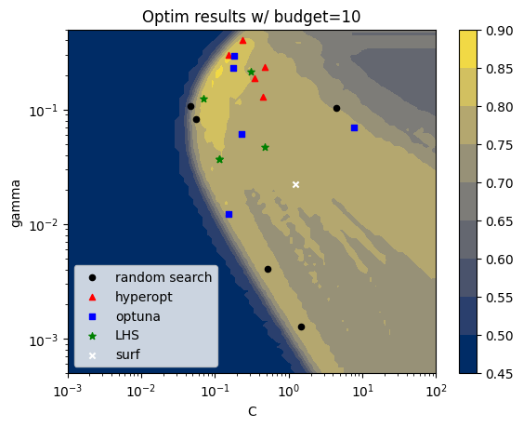
Notes:
Plot of optimal results from different experimental designs for the support vector machine model,
-- Color scale indicates the CV score
Each point represent one optimal result from a trial of 10 samples
we did 5 trials for the first 4 methods. The Response surface is deterministic, so only 1 point.
In general, all 5 design methods produced high-quality results, with CV scores all greater than 0.75.
the result of maximin LHD and hyperopt concentrate around the global optimum.
The optuna and random search have higher estimation variance.
the Surf algorithm did not make much movement beyond the center.

Slide 9
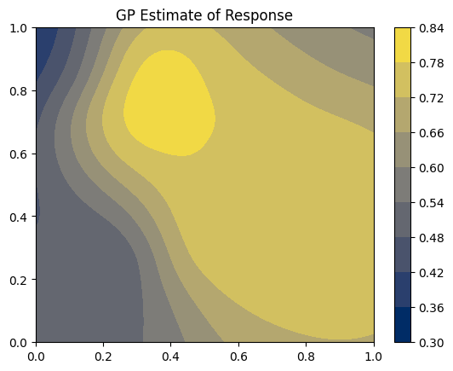

Slide 10
Conclusion
Preliminary results demonstrated the potential of DoE techniques in modern ML
LHSTuner is competitive against advanced algorithms (optuna, hyperopt).
Surf w/ steepest ascent: expensive and sub-optimal
GP analysis: double-edged sword
Notes:
Preliminary results demonstrated the potential of DoE techniques in modern ML.
The Latin hypercube method exhibited notable competitiveness relative to advanced algorithms.
The RSM implementation using the steepest ascent was comparably expensive and sub-optimal. Although the Plackett-Burman matrix can be utilized for cost-effective designs, scaling to a high dimension is still challenging for both first and second-order designs. Regardless, its performance is still highly dependent on the initialization of centers and step sizes. As a result, the efficacy of the steepest ascent is quite limited in HPO.
Optimized space-filling in conjunction with GP modeling also captures response behavior and quantifies its uncertainty, making results more interpretable. Nonetheless, here GP is only used for analysis; further experiments of a true sequential approach with Bayesian optimization can be conducted. A downside of the LHS+GP combination is that it still relies on the optimal choice of kernels, which may require even more computational resources and domain knowledge.

Slide 11
Reference
[1] Akiba, T., Sano, S., Yanase, T., Ohta, T., & Koyama, M. (2019, July). Optuna: A next-generation hyperparameter optimization framework. In Proceedings of the 25th ACM SIGKDD international conference on knowledge discovery & data mining (pp. 2623-2631).
[2] Bergstra, J., Bardenet, R., Bengio, Y., & Kégl, B. (2011). Algorithms for hyper-parameter optimization. Advances in neural information processing systems, 24.
[3] Bergstra, J., & Bengio, Y. (2012). Random search for hyper-parameter optimization. Journal of machine learning research, 13(2).
[4] Feurer, M., Hutter, F. (2019). Hyperparameter Optimization. In: Hutter, F., Kotthoff, L., Vanschoren, J. (eds) Automated Machine Learning. The Springer Series on Challenges in Machine Learning. Springer, Cham. https://doi.org/10.1007/978-3-030-05318-5_1
[5] Frazier, P. I. (2018). A tutorial on Bayesian optimization. arXiv preprint arXiv:1807.02811.
[6] Seeger, M. (2004). Gaussian processes for machine learning. International journal of neural systems, 14(02), 69-106.
[7] Watanabe, S. (2023). Tree-structured Parzen estimator: Understanding its algorithm components and their roles for better empirical performance. arXiv preprint arXiv:2304.11127.
[8] Wu, C. J., & Hamada, M. S. (2011). Experiments: planning, analysis, and optimization. John Wiley & Sons.

